Slide 1
Clinical Platform Point of View – Technical Direction
TAI
August 2021

Slide 2


Executive Summary
This PoV provides a technology strategy to align and enable CVS Business goals.
New CVS Purpose Statement: Bringing our heart to every moment of your health.
Opportunity
Conclusions
Recommendations
CVS definition of Clinical data
Customer, Patient and Member clinical data is spread across multiple systems and technologies
We need to deliver connected, consistent and personalized experiences to our customers
We need to simplify and unify our business processes and technology stacks
Align on target state of clinical
Alignment on Clinical Data strategy across the enterprise is imperative to deliver innovative and consistent capabilities and results
Current state clinical landscape within CVSH is fragmented within siloed lines of businesses.
Current state of the technology landscape is scattered across multiple vendors leading to complex integrations, customizations and high cost of ongoing maintenance.
Define what Clinical data is in CVSH
Consolidate clinical business areas to create common business synergies, capabilities and systems usage.
Prioritize focusing on centralizing Clinical capabilities for the enterprise, e.g. Payer Agnostic.
Pivot clinical business roadmaps to align with Enterprise strategy
To deliver cohesive and consistent customer experiences that align on a clinical technology stack on a true multi-tenant solution
Accelerate migrations across the enterprise

Slide 3
Clinical Platform Technical Direction Scope
In Scope
Necessary Actions
Capability Area
Clinical Platform
Care Management
Utilization Management
Align on capabilities
Evaluate vendors with the objective of scaling to enterprise
Adjust roadmaps according to enterprise aligned decisions
Wellness Management
Behavior
Health
Medication
Therapy
Provider
Interaction
Member
Incentives

Slide 4
Industry Research

Slide 5
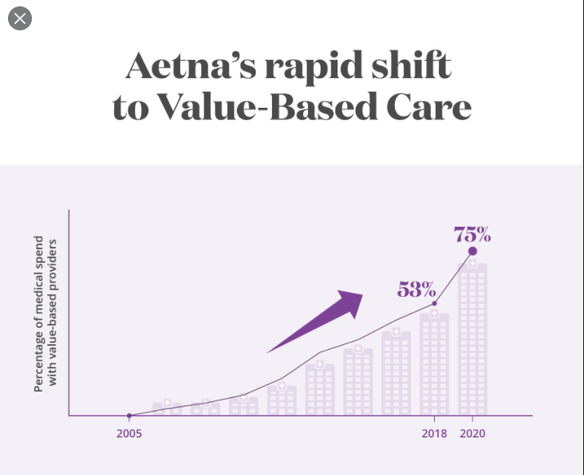
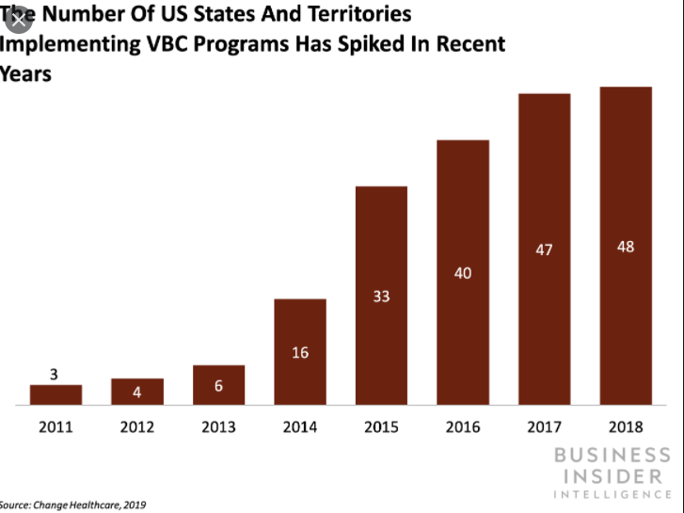
Care Management Market Trends
Trends: Influencing Change
Gartner Research as of January 2021
Market Definition
The primary payer care management workflow applications user is the payer-employed care manager (under titles such as nurse, care coordinator, health coach or health advocate). This person does the work of utilization management (UM), case management (CM), disease management (DM) or wellness program support.
Key Findings
Business, clinical and IT leaders are frustrated with incumbent care management solutions because of the difficulty in adapting solutions to changing requirements and implementing new medical management practices.
A new generation of care management solutions is emerging from cross-industry CRM vendors, visionary incumbents and internal development. These solutions are immature and carry high execution risk. As a result, it is a challenging time for mainstream payers to make a vendor selection decision.
In recent RFPs, there has been growing emphasis on a number of issues. These include process automation (especially for prior authorization); integrated medication therapy management; quality measurement; clinical data integration; community resource network management; analytics deployed into workflow; complaints, appeals and grievances (CAGs); and integration with member services to support the “health concierge” model.
Recommendations
Extend the life of your current care management solution for 24 months, if possible
Invest aggressively in a next-generation solution, built on composable business architecture, if your organization views care management as a primary market differentiator, is encumbered by your current solution and is willing to accept additional project risk.
Notes:
How does the industry define Care Management? :
- Care management is a promising team-based, patient-centered approach “designed to assist patients and their support systems in managing medical conditions more effectively." It also encompasses those care coordination activities needed to help manage chronic illness.
- McKinsey: as a payer driven effort to engage targeted members into their eco-systems to encourage high-valued decisions around the member’s care for self-management. Included in this definition includes: complex case-management, transition of care and condition management.
According to the CDC 60% of Adults in the US have a Chronic disease and 40% have 2 or more chronic diseases. - 90% of the Health care cost ($3.42 trillion) are for chronic or mental health conditions!
VBC (Value Based Contracting): is a healthcare reimbursement model that is based on quality of care rather than quantity. Fosters quality and cost outcomes, and greater accountability . As of Feb 2021: 84 percent of hospitals report participating in value-based care and 51 percent of provider practices.
65.5% of the spend for Commercial and Medicare is with a VBC provider
47.7% of Medicare members are in a VBC
- Why do I define Care Management and Value Based Contracting? Because of the attempted shift of care from the Payer to the Provider – or should I say from the Provider to the Payer? I was at HIMSS several years ago when I heard the Payer / Provider skit about care and payers calling the Patients..

Slide 6







Current Market Trends Care Management
Trends: Preparing for Change
Market Challenges
Building a composable architecture employing best-in-class vendors solutions and speed to implementing emerging technologies
Flexibility in choices of digital apps and devices used for condition management
Connected home technologies for health and engagement
Streamlining and automating administrative processes
Anticipating and quickly reacting to market trends, disruptors, and regulatory changes
Improving internal practices and building a data fabric ensuring readiness for next generation care management solutions
Enriching data assets curated from across more diverse and real-time data sources (e.g. geolocation, geospatial, IoT streams)
Advanced analytic techniques to personalize interactions
Flexible data services streamlining connectivity, communications, and interoperability across internal applications and vendor platforms
Focus on making care management a core technical competency
Actionable insights, proactive care intervention, and engagement
Differentiated Care Management capabilities become a growth enabler
Care Management platforms are in a generational transition
Vendors have been slow to implement emerging technologies needed to mitigate gaps in personalized care
Accessibility and fragmentation across numerous data sources
Innovative startup companies are lacking maturity in execution and challenged to gain market share
Notes:
I will try to curb my hope for greater Provider / Payer collaboration in health care as a whole however; with the growth of : VBC, Clinical Data Exchange, to newer regulations that endorse clinical data exchange and penalties surrounding data harboring – is encouraging that there will be better data movement.
Read highlights on the slide
Differentiation in offerings still playout in the market – more recently the EAP wins of GE and Amazon.

Slide 7
EHR Market Trends
89 percent of physicians reported using an EHR or EMR system.
According to Becker’s Health IT
Here's how major EHR vendors ranked in percentage of hospital market share in 2020:
Epic: 31 percent
Cerner: 25 percent
Meditech: 16 percent
CPSI: 9 percent
Allscripts: 5 percent
Medhost: 3 percent
Azalea Health: 0.5 percent
Unknown/custom: 0.5 percent
Other: 10 percent
Here is each major EHR vendor's net change in hospital market share in 2020:
Epic: +101
Azalea Health: +4
Allscripts: -1
Meditech: -9
CPSI: -12
Medhost: -12
Cerner: -19

Slide 8
Care Management Landscape

Slide 9

Current State of the Clinical landscape – Care Management
Takeaway : The clinical landscape rationalization and enterprise alignment is beginning.
Consumers
Ongoing investments
ATV has ongoing spend and planned investments in 22.
Significant investments are being made in MedCompass with more planned over 21/22/23 (supporting migrations)
Significant investments are being made in Epic
Ongoing investments in Datalink, Dynamo (to a lesser extent), third party vendors agreements such as Livongo, Ovia etc. are currently underway
HCB - Commercial
HCB - Medicare
Accordant, Coram, AHM
HCB -Medicaid
CET
Pharmacy Panel
ATV*
MedCompass
Epic (2) instances
Dynamo*
CEC/ESP
Clinical Enablement Engine (CEE)
Clinical Enablement Engine, developed as Clinical Orchestration for enterprise to insulate changes up & downstream
Digital
Clinical 360
Data Repositories
BoR’s
CDR
BoR’s
BoR’s
* Planned sunset and migration to MedCompass.
Clinical Platform
Notes: Datalink provides population health access for Value based contracting for the Medicare business. There are also other Care Management costs with third party vendors such as Livongo, Ovia etc.

Slide 10
Interim State of the Clinical landscape – Care Management
Takeaway : The clinical landscape is continuing rationalization and enterprise alignment key decisions need to be made
Consumers
Ongoing investments
ATV should have “limited” investments into 2023.
Significant investments are expected in MedCompass
Significant investments are expected in Epic
Determine HCB Commercial Care Management migration to either MC, Epic or SFHC
HCB - Commercial
HCB – Medicare
Medicaid
Accordant, Coram, AHM
CET
Pharmacy Panel
ATV*
MedCompass
Epic (2) Instances
CEC/ESP
Clinical Enablement Engine (CEE)
Clinical Enablement Engine, developed as Clinical Orchestration for enterprise to insulate changes up & downstream
Digital
Clinical 360
Data Repositories
BoR’s
CDR
BoR’s
BoR’s
All HCB government business has been migrated to MC
Clinical Platform
* Planned sunset of ATV and possible migration to SF Health Cloud and / or Epic as possible targets

Slide 11
Target State of the Clinical landscape – Care Management
Takeaway : The clinical landscape is continuing rationalization and enterprise alignment – number of systems are being reduced.
Consumers
Ongoing investments
ATV should have “limited” investments into 2023.
Significant investments are expected in MedCompass to support commercial migrations
Significant investments expected to be made in Epic to support Accordant Migration and Payer Agnostic build.
Decision HCB Commercial Care Management migration expected to SFHC
HCB - Commercial
HCB – Medicare
Medicaid
Accordant, Coram, AHM
CET
Pharmacy Panel
SFHC
MedCompass
Epic (1) Instance
CEC/ESP
Clinical Enablement Engine (CEE)
Digital
HCB Commercial investment in SFHC for Commercial business Care Management TO START.
Clinical 360
Data Repositories
BoR’s
CDR
BoR’s
Two Epic instances have been reduced to one. Accordant moves to the CVS Enterprise Epic instance.
BoR’s
Clinical Platform

Slide 12
Utilization Management Landscape

Slide 13
Current State of the Clinical landscape – Utilization Management
Takeaway : The clinical landscape rationalization and enterprise alignment.
Ongoing investments
ATV has ongoing spend and planned investments in 22.
Significant investments are being made in MedCompass with more planned over 21/22/23 (supporting migrations)
Research PBM Reimagine PA (Prior Authorization) effort is started. With the PBM goal of one system
HCB - Commercial
HCB - Medicare
HCB -Medicaid
Payer Agnostic
PBM
ATV*
MedCompass
QNXT*
ActiveAdvice
CAS, Novologix, PAscript, and MedHok
* Planned sunset and migration to MedCompass.

Slide 14
Interim State of the Clinical landscape – Utilization Management
Takeaway : The clinical landscape rationalization and enterprise alignment.
Ongoing investments
ATV should have “limited” investments into 2023 as UM migration continue to MC.
Significant investments are expected in MedCompass
Determine Payer Agnostic UM direction
Determine PBM direction
HCB - Commercial
HCB - Medicare
HCB -Medicaid
Payer Agnostic
PBM
MedCompass
ActiveAdvice
CAS and Novologix

Slide 15
Target State* of the Clinical landscape – Utilization Management
Takeaway : The clinical landscape rationalization and enterprise alignment.
* Need Business alignment.
Ongoing investments
Continued investments are expected in MedCompass
Significant investments are expected in Novologix
Determine the Payer Agnostic UM direction
HCB - Commercial
HCB - Medicare
HCB -Medicaid
Payer Agnostic
PBM
MedCompass
??
Novologix
Enterprise needs to align on picking specific vendors for capabilities, for example Care Management capability will be delivered by SF Health Cloud or Epic and billable Patient encounters capabilities will be delivered by Epic etc..

Slide 16
Clinical landscape for CM and UM – Target State Pros vs Cons
Positives
Negatives
SFHC: Time to market, costs, customizable, responsive
Epic: Clinically proven system
Epic: Designated CVS Clinical EHR system of choice
MC: Business likes UM
UM: Pre-Cert automation is just beginning
Epic: Time to market, costs, not easily customizable, responsive
MC: Known scaling issues and not favorable CM capabilities
Business did not evaluate SF Velocity for UM
With multiple CM systems there is a risk of multiple or overlapping, competing clinical programs across CVS Health
Considerations
Value Base Contracts: Shift Care Management to Providers. Many Providers use Epic for their EMR
Legal Vetting: Need to know if Care Management Notes are allowed in Epic and Care managers can share notes with Providers
Chronic Care Management: Place all Chronic (Disease) Condition programs in Payer Agnostic (Epic) flows.

Slide 17
Into Action.

